Slide 1

BEARR: BEautiful And unsupeRvised exotic lens discoveRy
Diego Miura, Abheek Dhawan
ASTR 3560
Final Project
Notes:
Very roughly, the idea is to take a large set of microlensing light curves, turn them into numerical features, and then use dimensionality reduction and clustering to see whether distinct families of light-curve shapes naturally emerge.
In the long run, this kind of approach could help real-time microlensing pipelines go beyond simple single-lens fits and automatically highlight exotic events, like binaries or planetary lenses, for follow-up.
Butterfly
Unsupervised exotic lens discovery
Teddy Bear

Slide 2
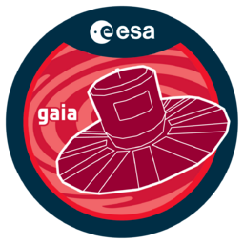


Motivation
Pantoja et al. (2022): Combining hand-crafted light-curve features with UMAP and HDBSCAN on OGLE/CSS/Gaia data produces clusters that line up with classical variable-star classes.
Explore Large Datasets
Build Training Sets
Potentially discover new sub-classes.
Our project: apply the same unsupervised-clustering philosophy to microlensing OGLE light curves, looking for families of microlensing morphologies and exotic events without needing a huge labeled training set.
Notes:
Before diving into our own microlensing work, I want to highlight a key motivation: the paper by Pantoja et al. from 2022.
They looked at large catalogs of variable stars from OGLE, the Catalina Sky Survey, and Gaia. These surveys produce millions of light curves, so manually labeling everything is impossible, and even supervised machine-learning approaches struggle because they need large, clean training sets.
Pantoja and collaborators took a different route. They extracted a rich set of features from each variable-star light curve, then used UMAP to project those features into a low-dimensional space, and applied HDBSCAN to cluster the points. The really important result is that these purely unsupervised clusters line up very well with the classical variable-star classes from the literature: most clusters have over 90% purity at the class level and over 80% at the sub-class level.
That’s a strong proof of concept that unsupervised clustering on survey light curves can recover physically meaningful classes, and can be used both to explore the structure of the dataset and to build better training sets for supervised models later.
Our project is basically bringing that same philosophy into the microlensing regime. Instead of periodic variable stars, we’re working with OGLE microlensing light curves, and asking: if we extract the right features and apply similar unsupervised tools, do we naturally recover different families of microlensing morphologies and pick out the more exotic events?

Slide 3
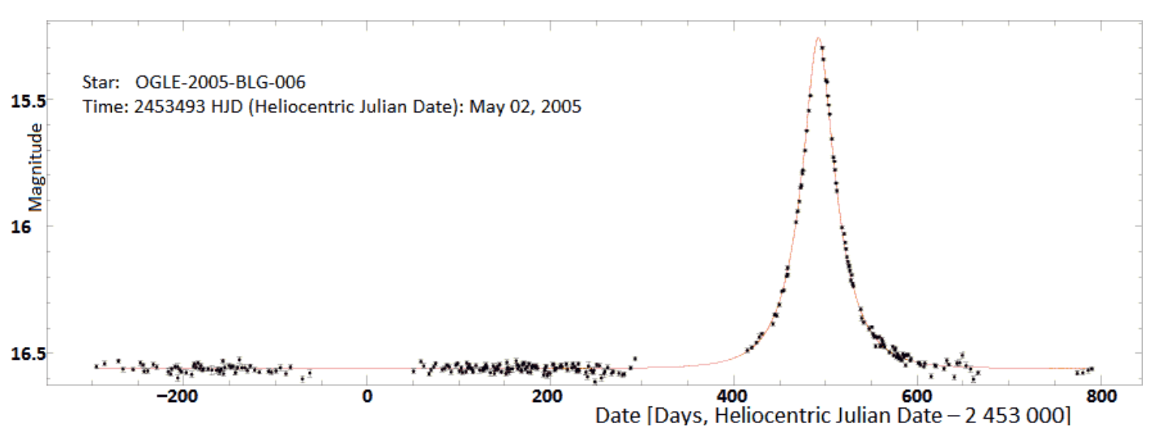
Lensing
Massive object (lens) aligns in front of a background source object, temporarily brightening the source.
Gravity bends light → time-variable magnification.
Key parameters (for a single lens):
Peak Time t₀
Peak Magnification / Amplitude
Event Timescale t_{E}
https://en.wikipedia.org/wiki/Gravitational_microlensing
Notes:
Just to set the stage, in gravitational microlensing a foreground mass, usually a star, sometimes with planets, passes almost exactly in front of a background source star.
The gravitational field of the lens bends the light rays and magnifies the source. As the alignment changes over time, the observed brightness changes, so what we actually measure is a light curve: brightness versus time.
For a simple, single point-mass lens, the light curve has a very characteristic symmetric shape. It’s described by a few parameters: the time of maximum magnification t₀​, the event timescale t_{E}, and a peak magnification that depends on the impact parameter. That simple form is what the standard OGLE pipeline assumes.

Slide 4
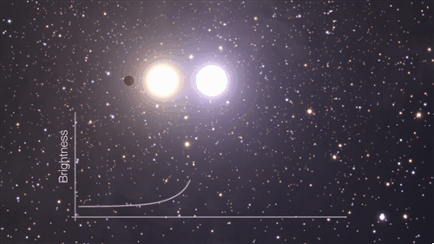
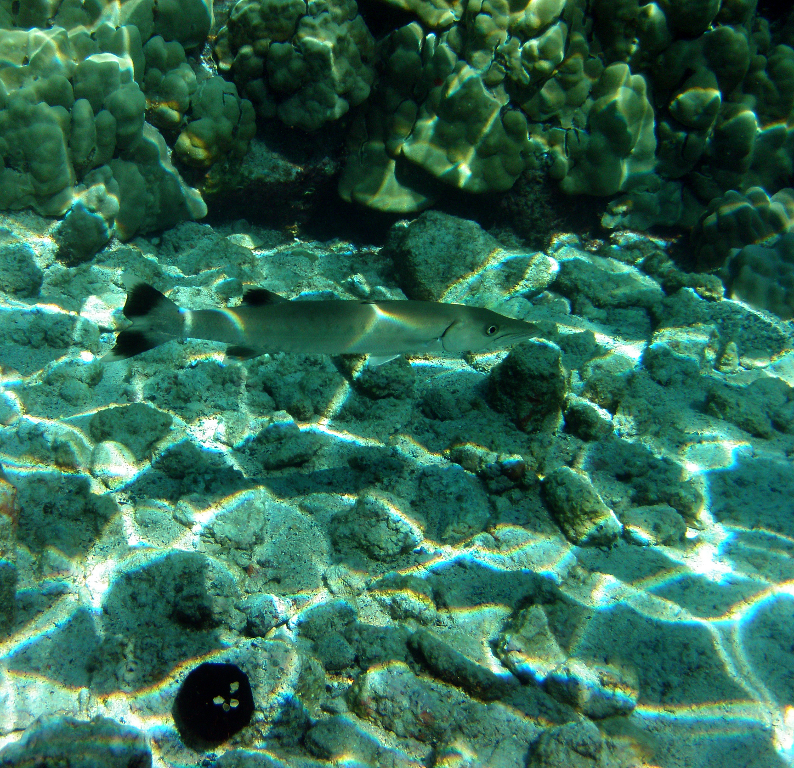
Single-Lens vs Complex Events
Single Lens:
Smooth, Symmetric “Paczyński” curve.
Binary/Planetary Lenses:
Caustics
Asymmetries, Multiple Bumps, “shoulders”
https://en.wikipedia.org/wiki/Gravitational_microlensing
https://en.wikipedia.org/wiki/Caustic_(optics)
Notes:
The clean, symmetric curve you see in the figure is what you expect from a single-lens event: one smooth peak, symmetric around t₀​.
But real life is messier. If the lens has a companion, like a binary star or a planet, then we get caustic structures in the lensing geometry. When the source crosses or approaches those caustics, the light curve can show sharp spikes, multiple bumps, or asymmetries.
Those complex shapes are scientifically rich, but they don’t fit the simple PSPL model well. So, in this project, those are exactly the kinds of events we hope our clustering method can automatically pick out as distinct groups.

Slide 5
The OGLE Microlensing Data
Survey: Optical Gravitational Lensing Experiment (OGLE-III/IV).
Real-time Early Warning System (EWS) publishes candidate microlensing events. We used 2025 events (1496 in total)
For each:
Light curves in I-band
OGLE PSPL model parameters
We focus on light-curve morphology, not detailed lens modeling, so we work in feature space.
https://ogle.astrouw.edu.pl/ogle4/ews/ews.html
Notes:
For data, we use microlensing events from the OGLE survey, specifically all 1496 of the 2025 events
Each event is an I-band light curve with measurements of magnitude or flux as a function of time. In our sample we focus on events that have reasonably good sampling around the peak and enough points to make the features meaningful.
The EWS analyzes photometry of all stars in the field and flags a star when it is detected in the difference images five times in a row. For microlensing event detection only objects increasing brightness are marked. Initial filtering masks the objects which were detected in difference images during the previous observing seasons (3-10% of all stars in the frame) to avoid false signals by variable stars.
The light curves of flagged stars are inspected visually, their positions on the recent CCD frames are checked for bad pixels, bleeding columns, very bright neighboring stars etc. If a star passes all these checks, it is announced as a microlensing candidate.
POINT SOURCE POINT LENS

Slide 6
From light curves to features
Preprocessing
Start with 20 simple features
FHWM time
Flux mean
Duration
End with as many features as possible: 60 features
Flux Asymmetry
Rise to Fall Ratio
Flux Error Median
Many more…
Notes:
Briefly mention 3-5 features
To cluster events, we first need to turn each light curve into a set of numbers — that’s our feature engineering step.
We start by preprocessing: we roughly align each light curve in time so that t₀≈0, and we normalize the flux or magnitude so that we’re looking at changes relative to a baseline. We can also handle outliers or bad points so they don’t dominate the features.
Then we compute shape-based features: things like an estimate of the event duration or width, the peak amplitude, measures of asymmetry between the rising and falling parts of the curve, and indicators of multiple peaks or shoulders. On top of that, we can include parameters or residuals from a simple PSPL fit, so we’re encoding “how badly does a single lens describe this event.”
The end result is a feature matrix where each event is represented by a vector in some high-dimensional space.

Slide 7
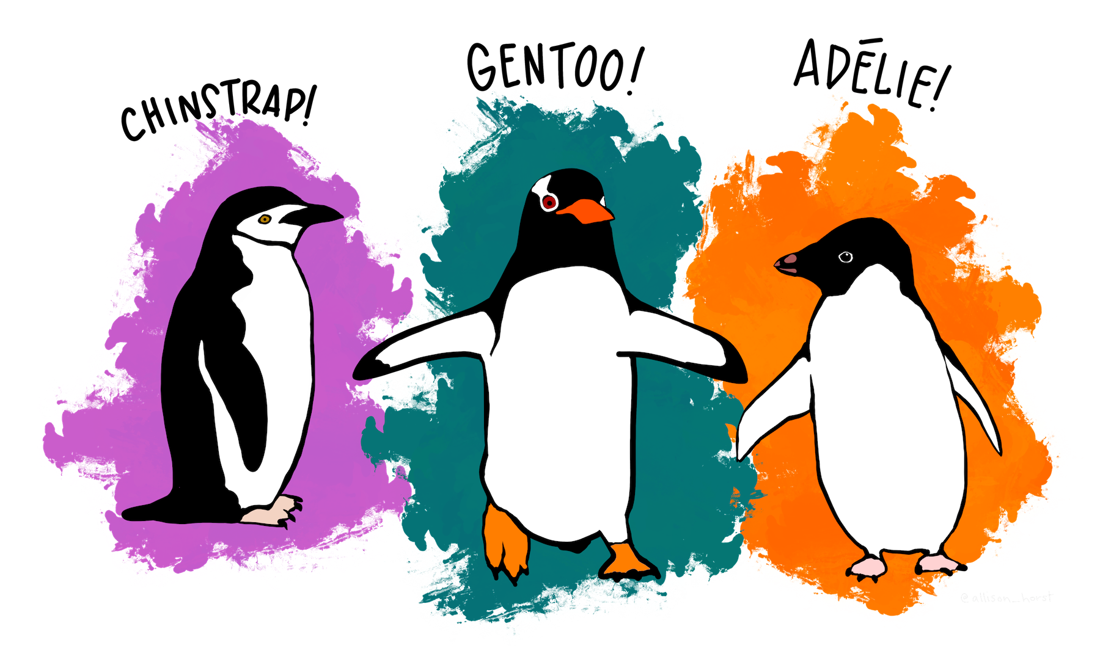
UMAP: Uniform Manifold Approximation and Projection
Want to separate three different kinds of penguins based on features
https://umap-learn.readthedocs.io/en/latest/basic_usage.html
Notes:
High-dimensional feature spaces are hard to visualize and can be tricky for clustering. So our next step is dimensionality reduction.
We use UMAP, which is a non-linear method that tries to preserve the local neighborhood structure of the data. Events that are similar in feature space end up close together in 2D; events that are very different are farther apart.
→ There is a broad category of unsupervised learning tasks which deals with “simplification” processes.
→ These techniques are used to make data set smaller, more manageable, and easier to visualize with minimal loss of information

Slide 8
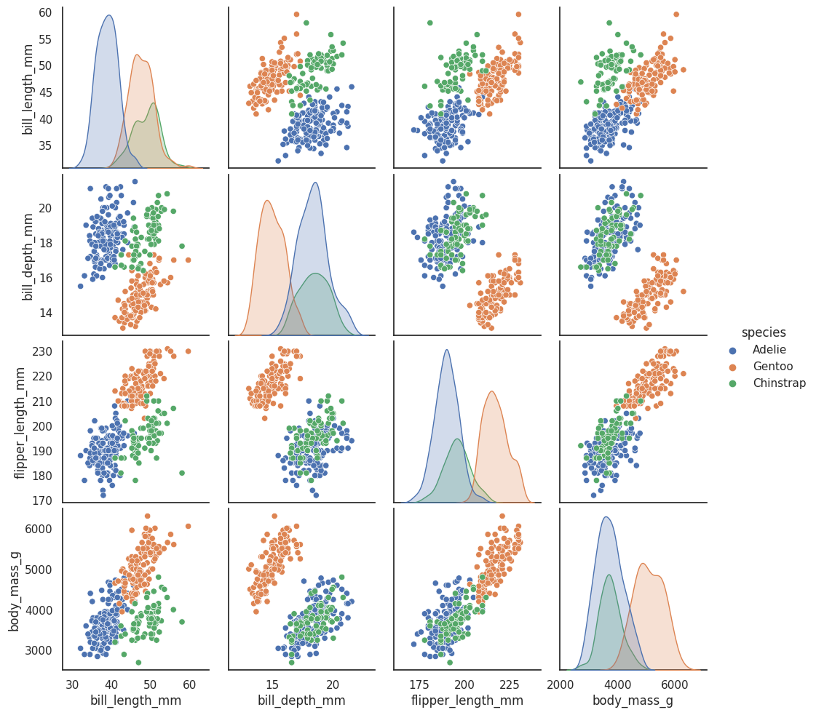
UMAP: Uniform Manifold Approximation and Projection
Can try pairwise plotting to reveal “latent” features
https://umap-learn.readthedocs.io/en/latest/basic_usage.html
Notes:
High-dimensional feature spaces are hard to visualize and can be tricky for clustering. So our next step is dimensionality reduction.
We use UMAP, which is a non-linear method that tries to preserve the local neighborhood structure of the data. Events that are similar in feature space end up close together in 2D; events that are very different are farther apart.
On this slide, you’re seeing each event as a single point in the 2D UMAP plane. At this stage, the colors are just [say what you used, maybe all grey, or colored by a simple property like timescale], but the important idea is that the structure in this plot reflects similarities in light-curve shape.

Slide 9
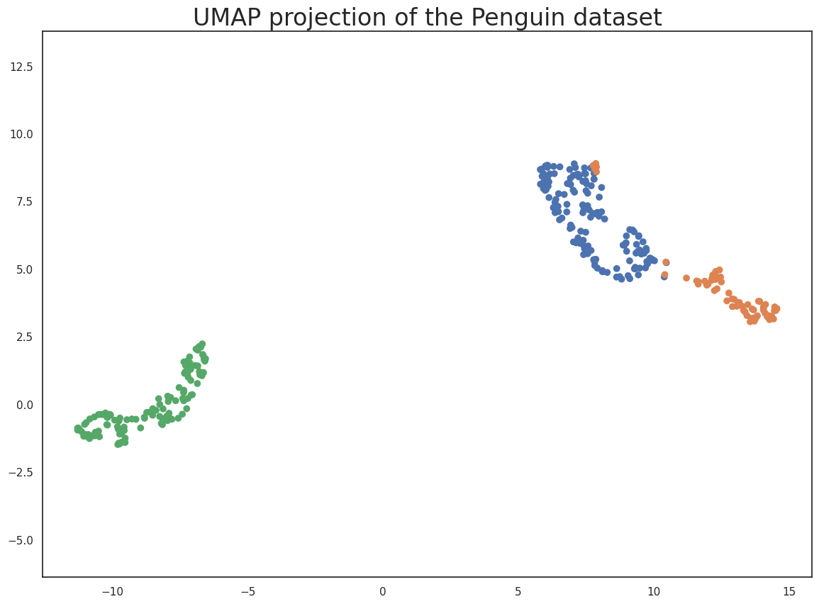
UMAP: Uniform Manifold Approximation and Projection
UMAP dimensionality reduction preserves relations
https://umap-learn.readthedocs.io/en/latest/basic_usage.html
Notes:
High-dimensional feature spaces are hard to visualize and can be tricky for clustering. So our next step is dimensionality reduction.
We use UMAP, which is a non-linear method that tries to preserve the local neighborhood structure of the data. Events that are similar in feature space end up close together in 2D; events that are very different are farther apart.
On this slide, you’re seeing each event as a single point in the 2D UMAP plane. At this stage, the colors are just [say what you used, maybe all grey, or colored by a simple property like timescale], but the important idea is that the structure in this plot reflects similarities in light-curve shape.

Slide 10
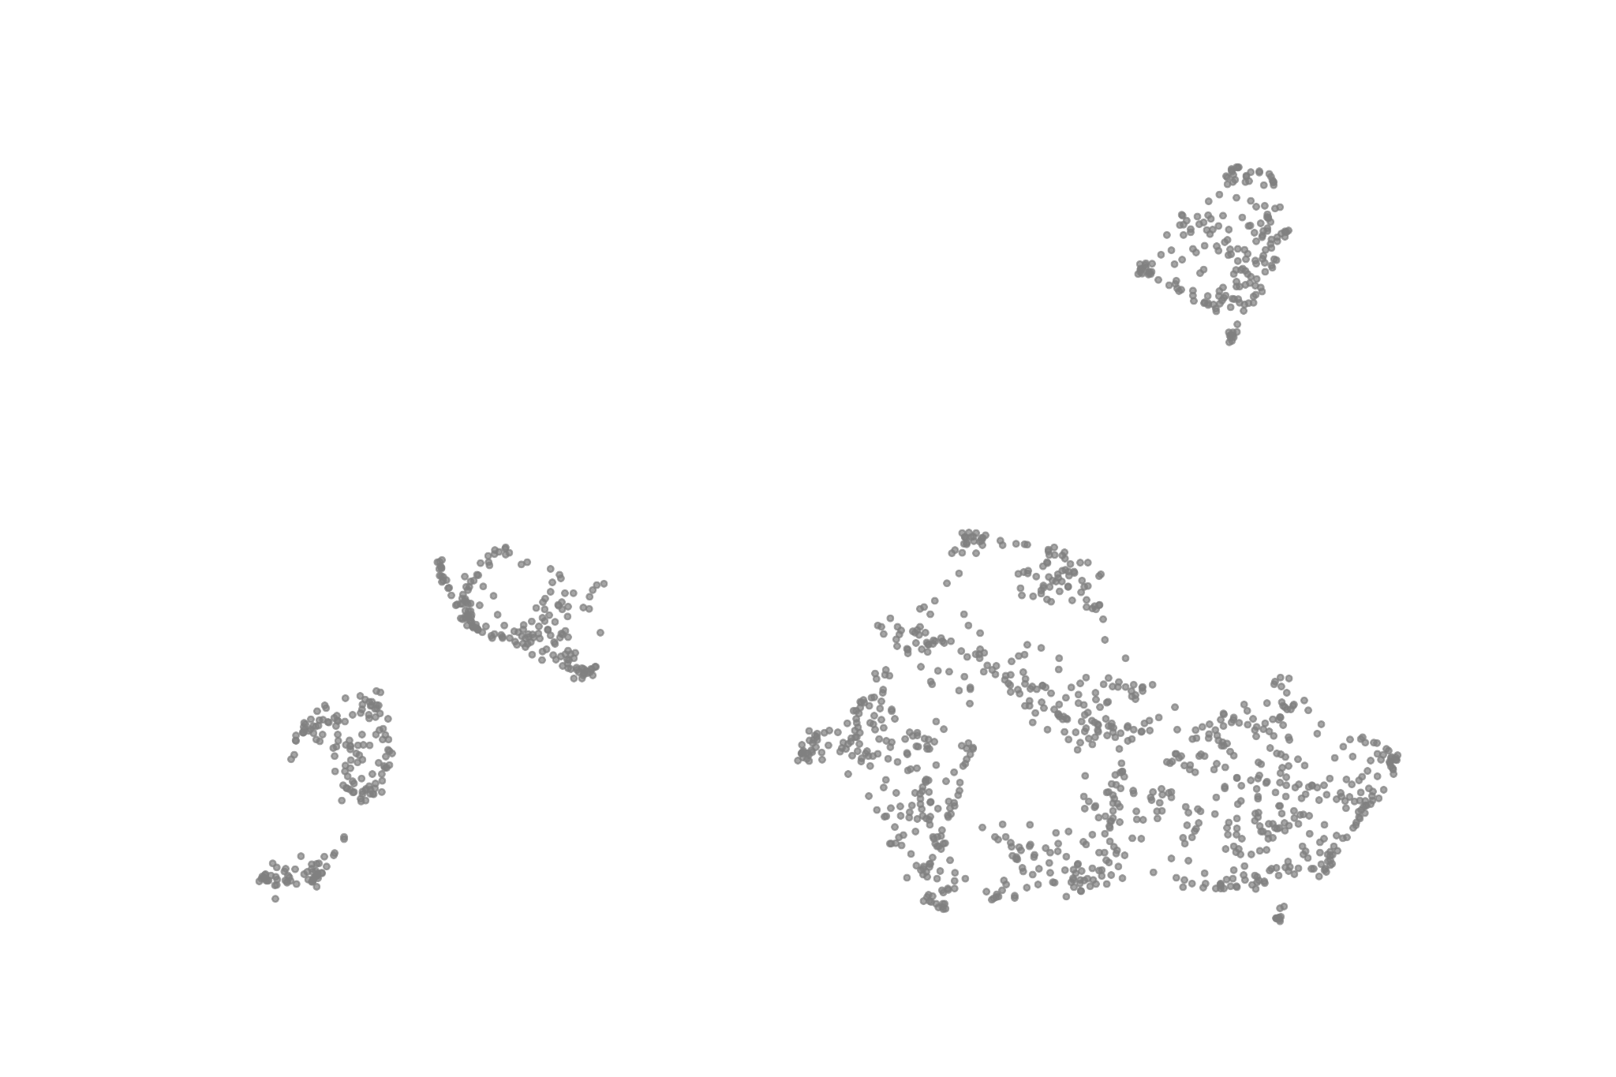
Dimensionality Reduction with UMAP
Feature space is high-dimensional → hard to visualize directly.
Use UMAP to embed events in 2D for visualization:
preserves local structure (similar light curves stay close)
good for complex, non-linear manifolds.
Result: each event = a point in a 2D “morphology map”.
Notes:
High-dimensional feature spaces are hard to visualize and can be tricky for clustering. So our next step is dimensionality reduction.
We use UMAP, which is a non-linear method that tries to preserve the local neighborhood structure of the data. Events that are similar in feature space end up close together in 2D; events that are very different are farther apart.
On this slide, you’re seeing each event as a single point in the 2D UMAP plane. At this stage, the colors are just [say what you used, maybe all grey, or colored by a simple property like timescale], but the important idea is that the structure in this plot reflects similarities in light-curve shape.

Slide 11
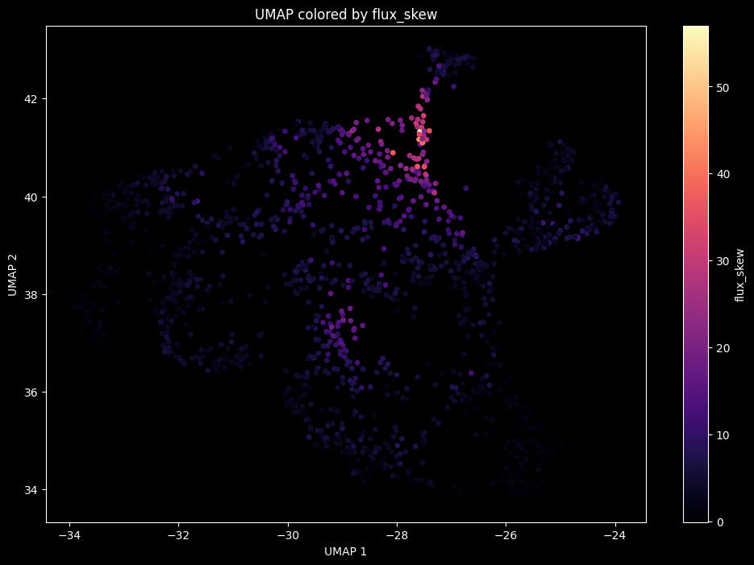

Slide 12
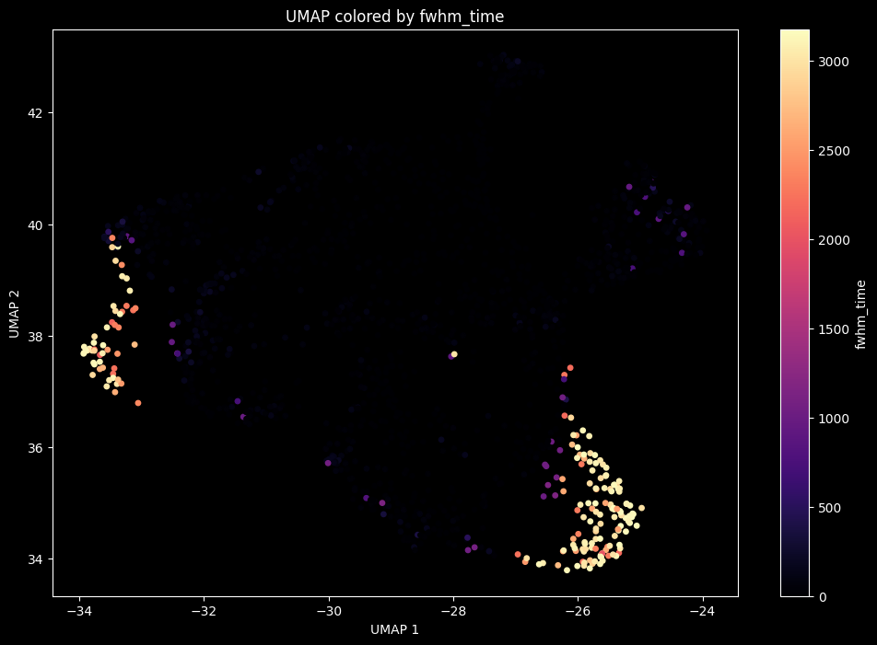

Slide 13
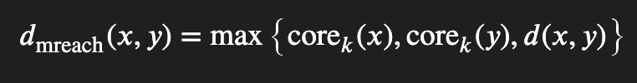
Clustering with HDBSCAN
Clusters = regions where points are dense, separated by low-density regions
HDBSCAN generalizes this by:
Defining core distance of each point
Defining mutual reachability distance
Building a minimum spanning tree
https://hdbscan.readthedocs.io/en/latest/how_hdbscan_works.html
Notes:
Once we have the 2D UMAP embedding, we apply HDBSCAN, which is a density-based clustering algorithm. It’s well-suited for this problem because it doesn’t force the data into spherical clusters and it can identify noise points.
Intuitively, HDBSCAN looks for regions in the UMAP plane where points are densely packed and assigns them to clusters. Points that are isolated or in low-density regions can be labeled as “noise.”
On this slide, you can see the same UMAP projection, but now each point is colored by its HDBSCAN cluster label, with noise in grey. You can see that the algorithm naturally finds [X] main clusters plus a cloud of outliers. These clusters are candidates for distinct families of microlensing light-curve morphologies.

Slide 14
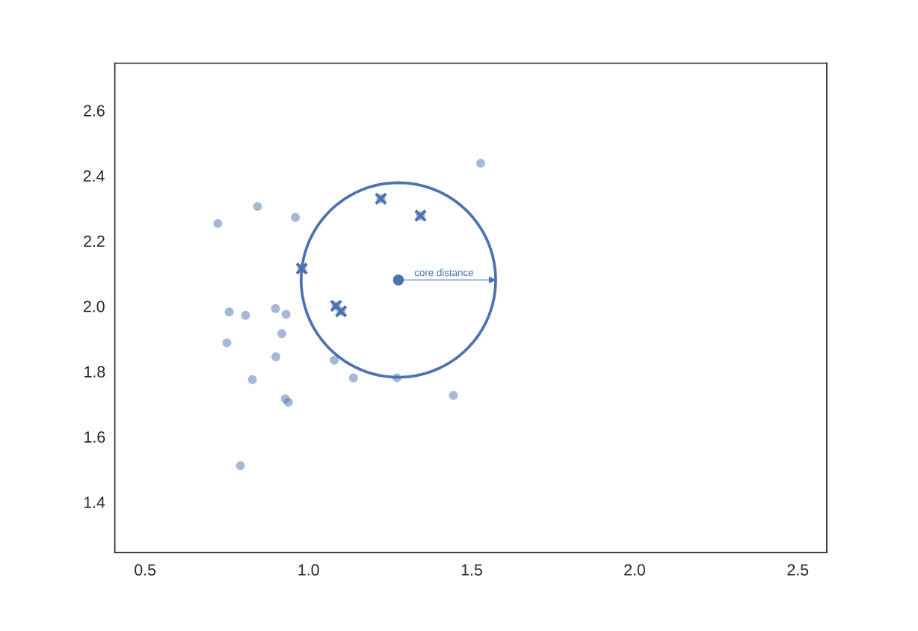
Clustering with HDBSCAN
Gradually lowering a density threshold, turning the MST into a hierarchy of clusters.
It then selects clusters that are most stable as the threshold changes:
Points in very dense, persistent regions → assigned to clusters.
Points in low-density or ambiguous regions → labeled as noise.
https://hdbscan.readthedocs.io/en/latest/how_hdbscan_works.html
Notes:
Once we have the 2D UMAP embedding, we apply HDBSCAN, which is a density-based clustering algorithm. It’s well-suited for this problem because it doesn’t force the data into spherical clusters and it can identify noise points.
Intuitively, HDBSCAN looks for regions in the UMAP plane where points are densely packed and assigns them to clusters. Points that are isolated or in low-density regions can be labeled as “noise.”
On this slide, you can see the same UMAP projection, but now each point is colored by its HDBSCAN cluster label, with noise in grey. You can see that the algorithm naturally finds [X] main clusters plus a cloud of outliers. These clusters are candidates for distinct families of microlensing light-curve morphologies.

Slide 15
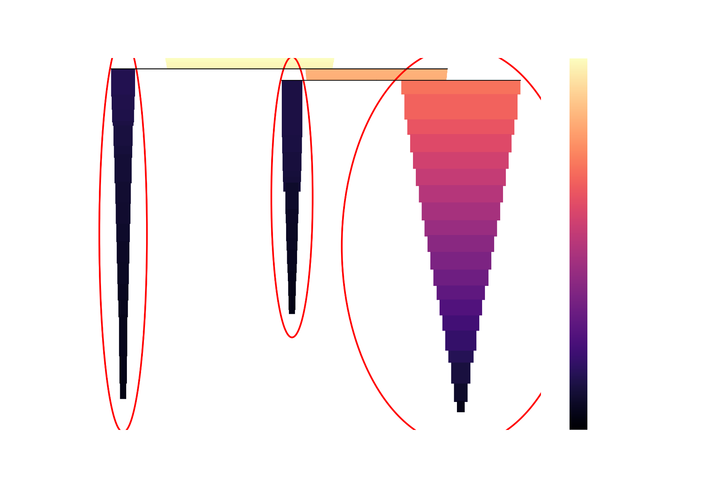
Clustering with HDBSCAN
Notes:
Once we have the 2D UMAP embedding, we apply HDBSCAN, which is a density-based clustering algorithm. It’s well-suited for this problem because it doesn’t force the data into spherical clusters and it can identify noise points.
Intuitively, HDBSCAN looks for regions in the UMAP plane where points are densely packed and assigns them to clusters. Points that are isolated or in low-density regions can be labeled as “noise.”
On this slide, you can see the same UMAP projection, but now each point is colored by its HDBSCAN cluster label, with noise in grey. You can see that the algorithm naturally finds [X] main clusters plus a cloud of outliers. These clusters are candidates for distinct families of microlensing light-curve morphologies.

Slide 16
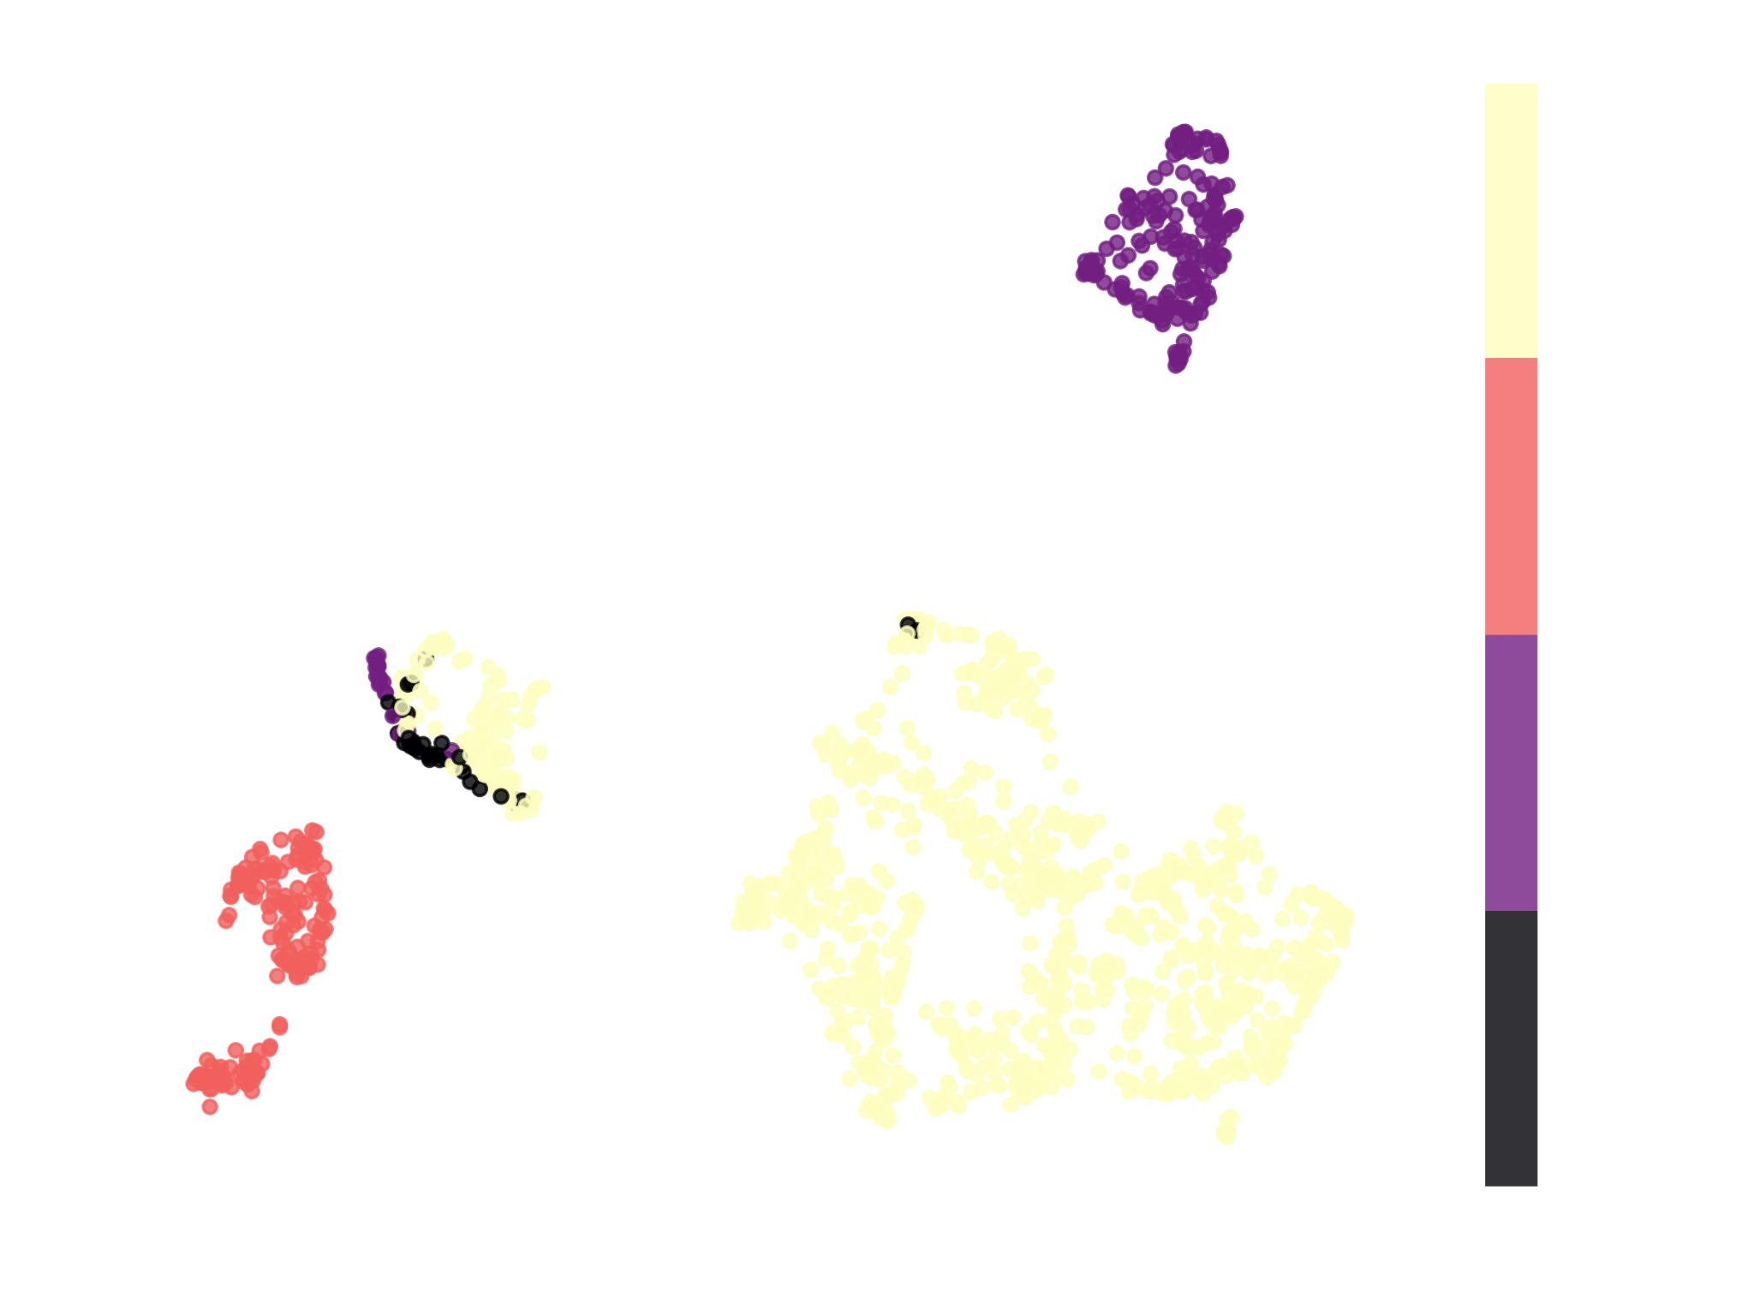
Cluster Strength
Ended up with 3 clusters, all quite strong (persistence ~0.5).

Slide 17
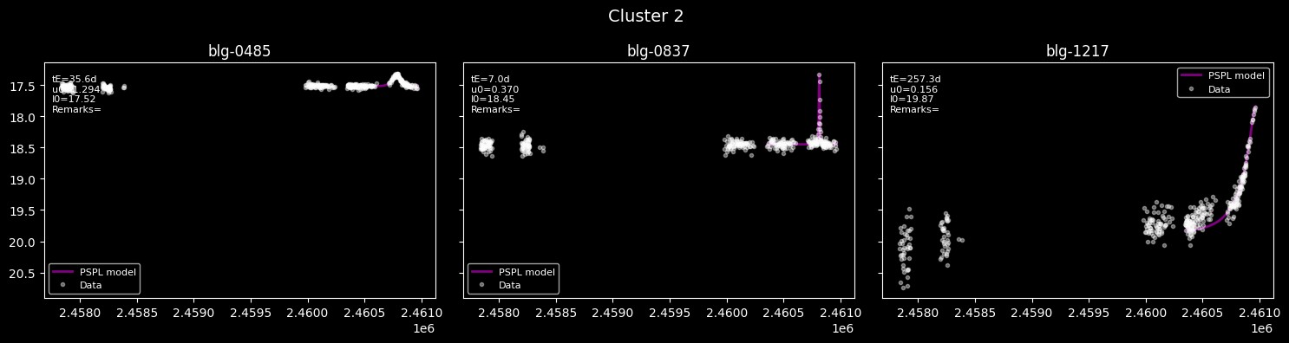

Slide 18
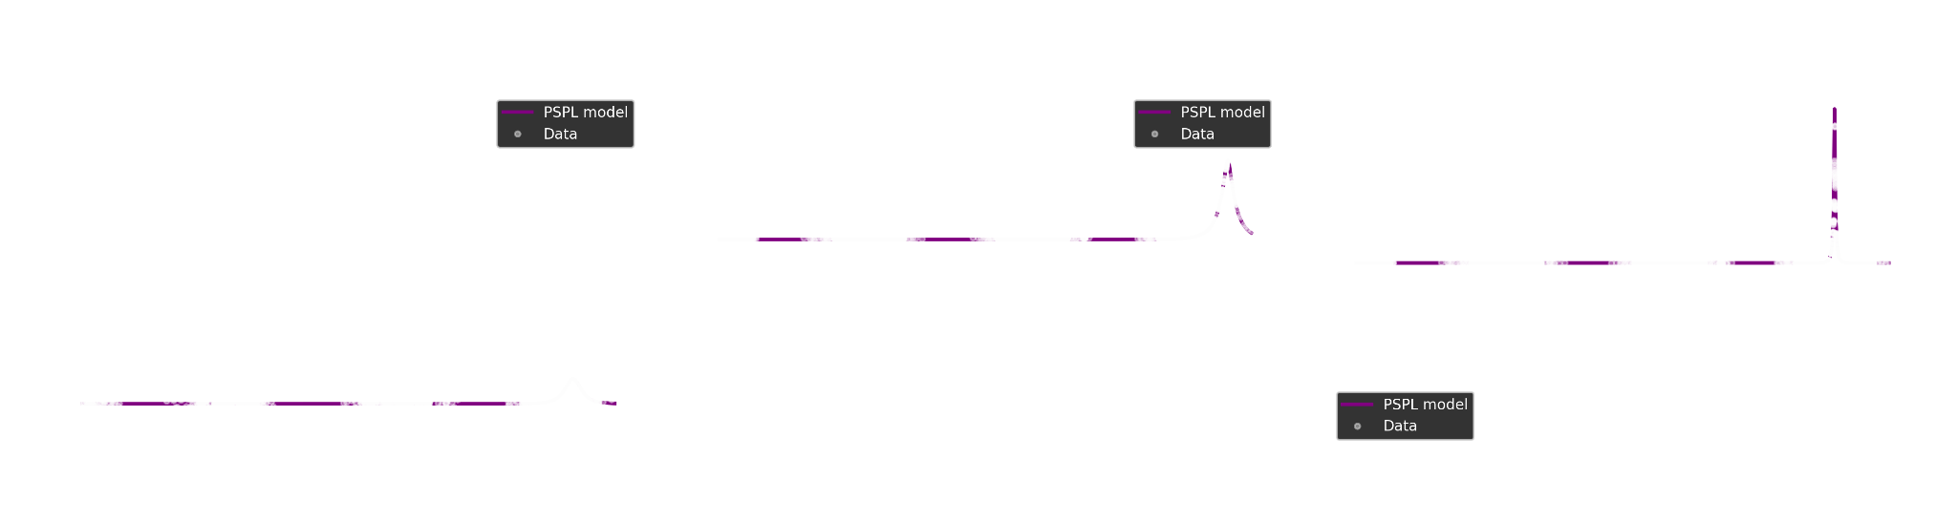
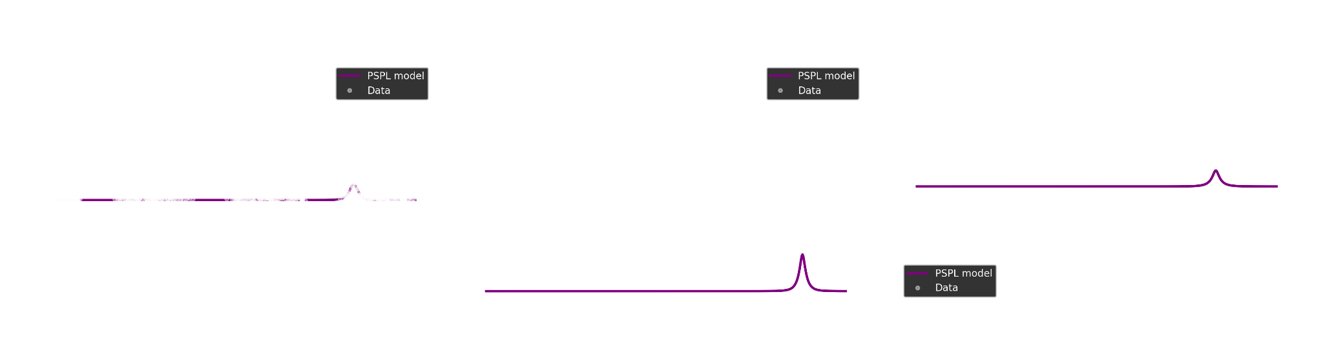
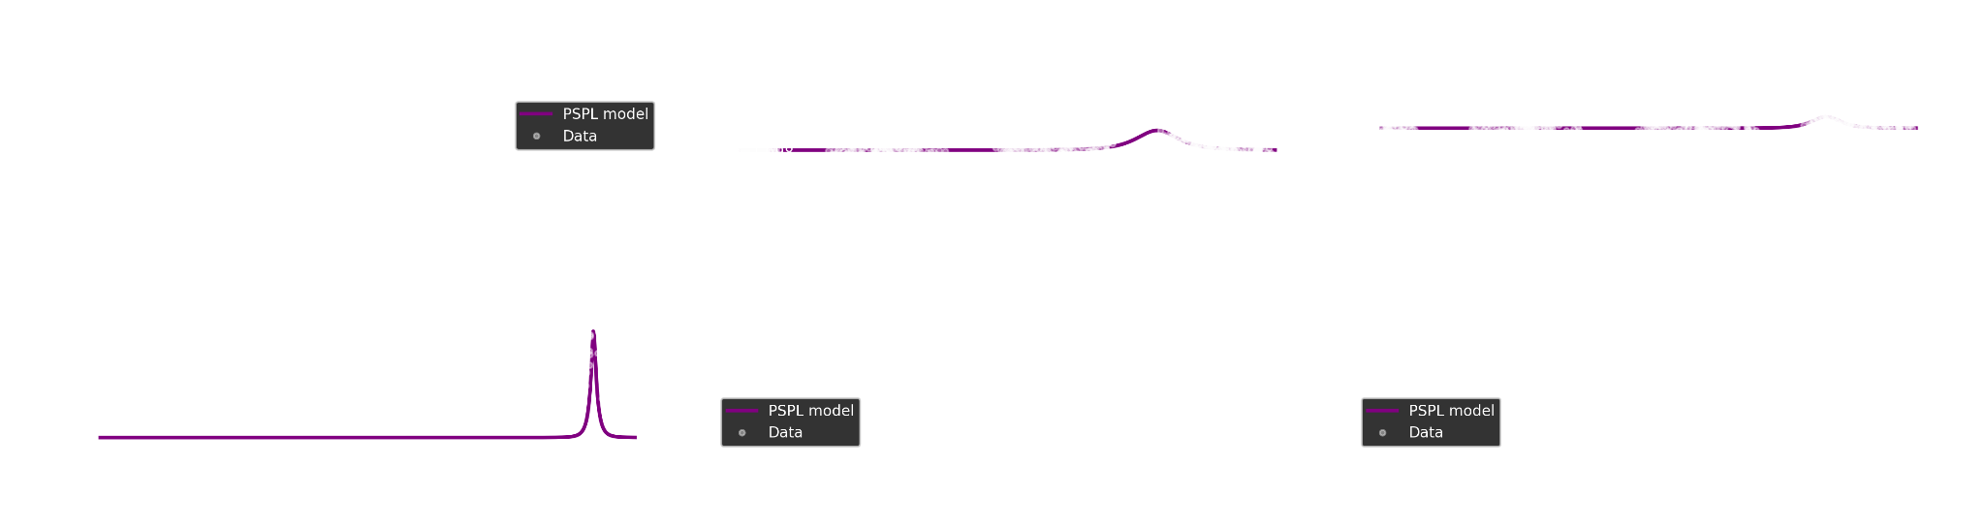
Notes:
To understand what these clusters actually mean, we go back to the light curves. For each major cluster, we look at representative events.
In the examples shown here, Cluster C0 [describe: e.g., “is dominated by clean, symmetric, single-lens-like curves”]. Cluster C1 [e.g., “tends to have asymmetries or shoulders”], and Cluster C2 [e.g., “contains clearly multi-peaked or caustic-like events”]. The noise points often correspond to events with sparse sampling, large gaps, or generally messy data.
The main takeaway is that the clustering is not arbitrary, each cluster has a recognizable light-curve style. That suggests that the combination of our features, UMAP, and HDBSCAN is capturing physically and observationally meaningful differences between events.

Slide 19
More features

Slide 20
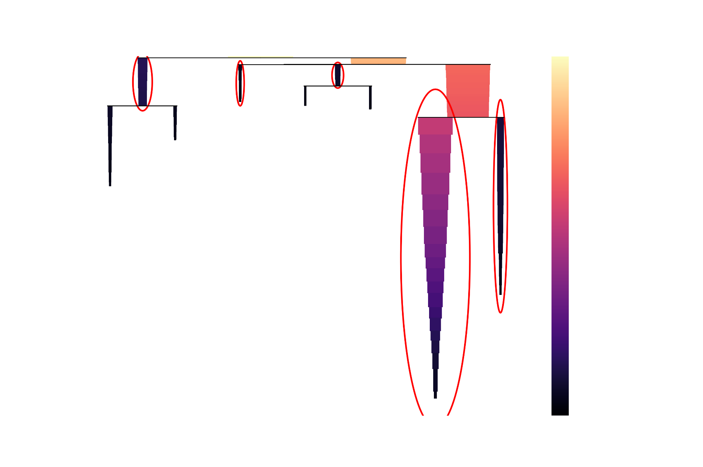
Clustering with HDBSCAN
Notes:
60 features -> no dimensionality reduction -> clustering

Slide 21
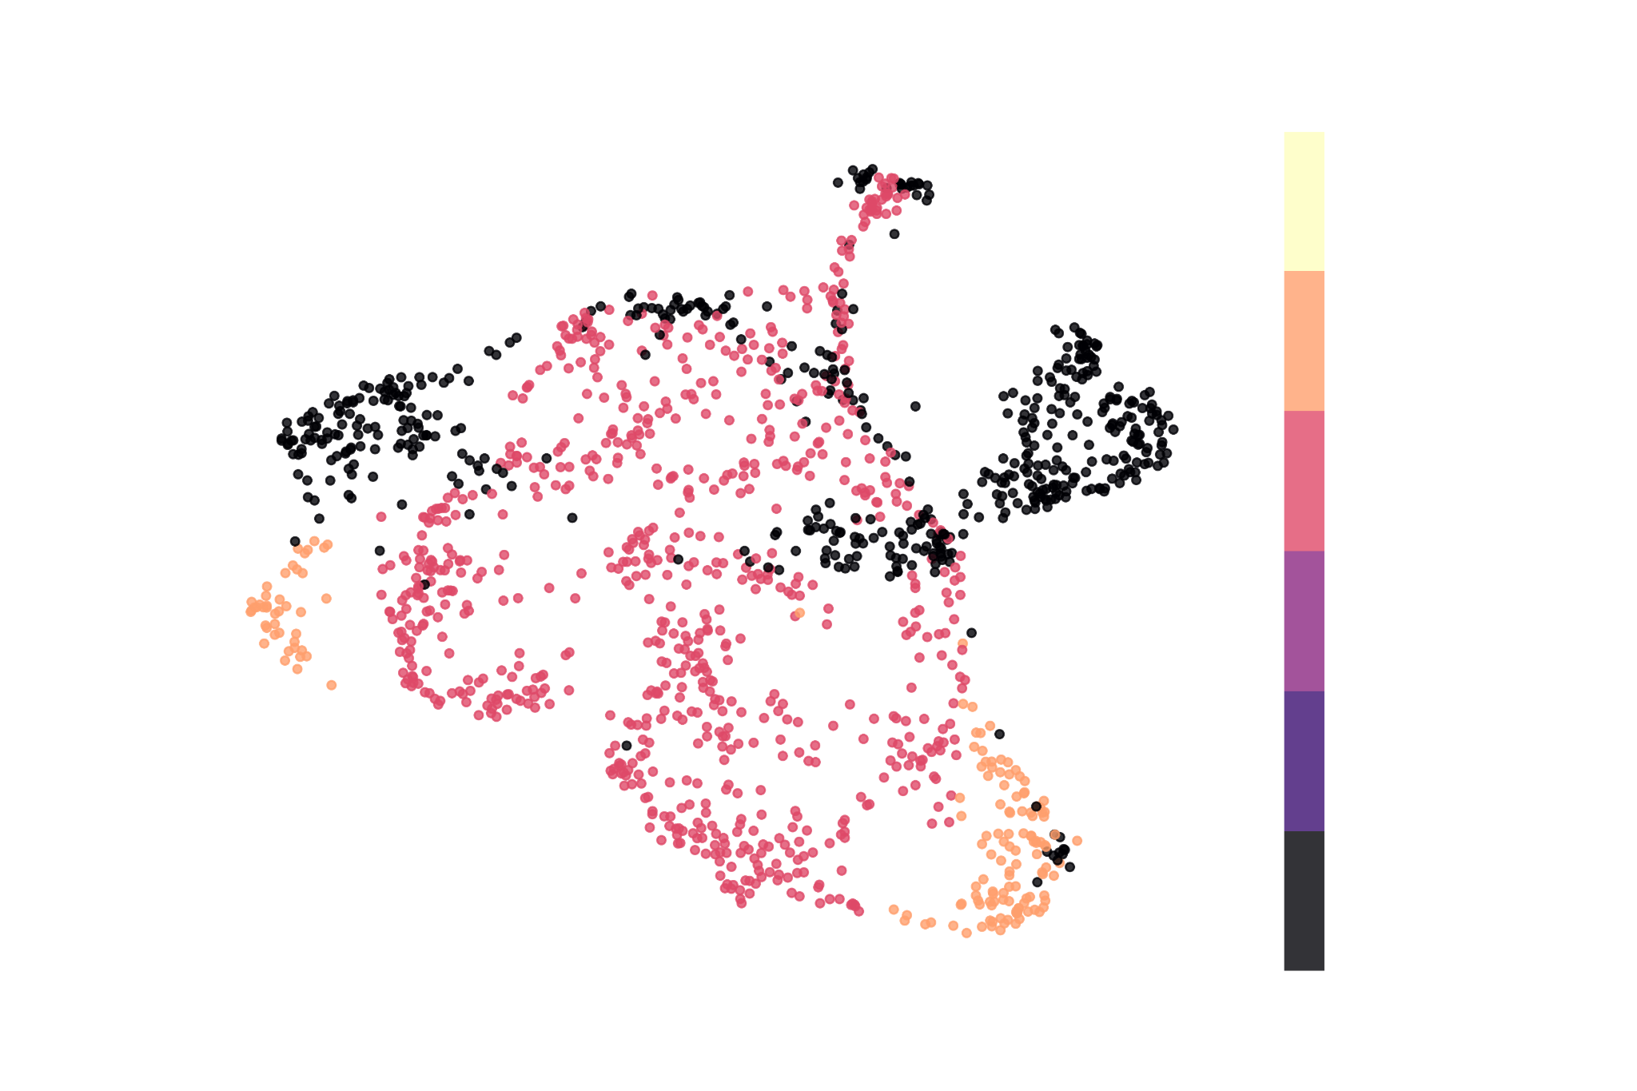
Cluster Strength
Ended up with 2 clusters, first one very strong, second one borderline.

Slide 22
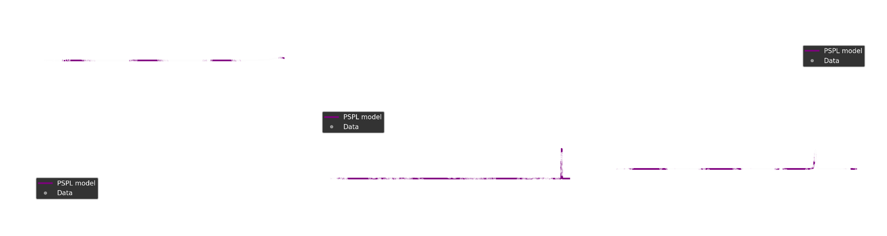
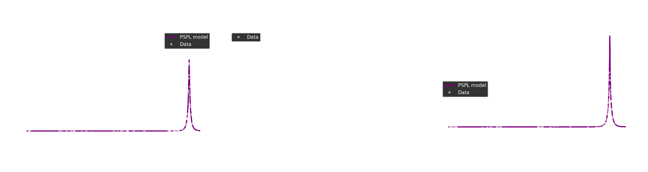
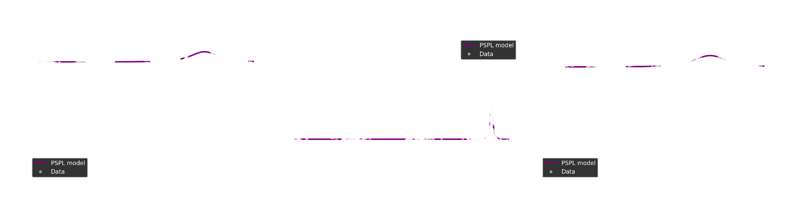
Notes:
To understand what these clusters actually mean, we go back to the light curves. For each major cluster, we look at representative events.
In the examples shown here, Cluster C0 [describe: e.g., “is dominated by clean, symmetric, single-lens-like curves”]. Cluster C1 [e.g., “tends to have asymmetries or shoulders”], and Cluster C2 [e.g., “contains clearly multi-peaked or caustic-like events”]. The noise points often correspond to events with sparse sampling, large gaps, or generally messy data.
The main takeaway is that the clustering is not arbitrary, each cluster has a recognizable light-curve style. That suggests that the combination of our features, UMAP, and HDBSCAN is capturing physically and observationally meaningful differences between events.

Slide 23
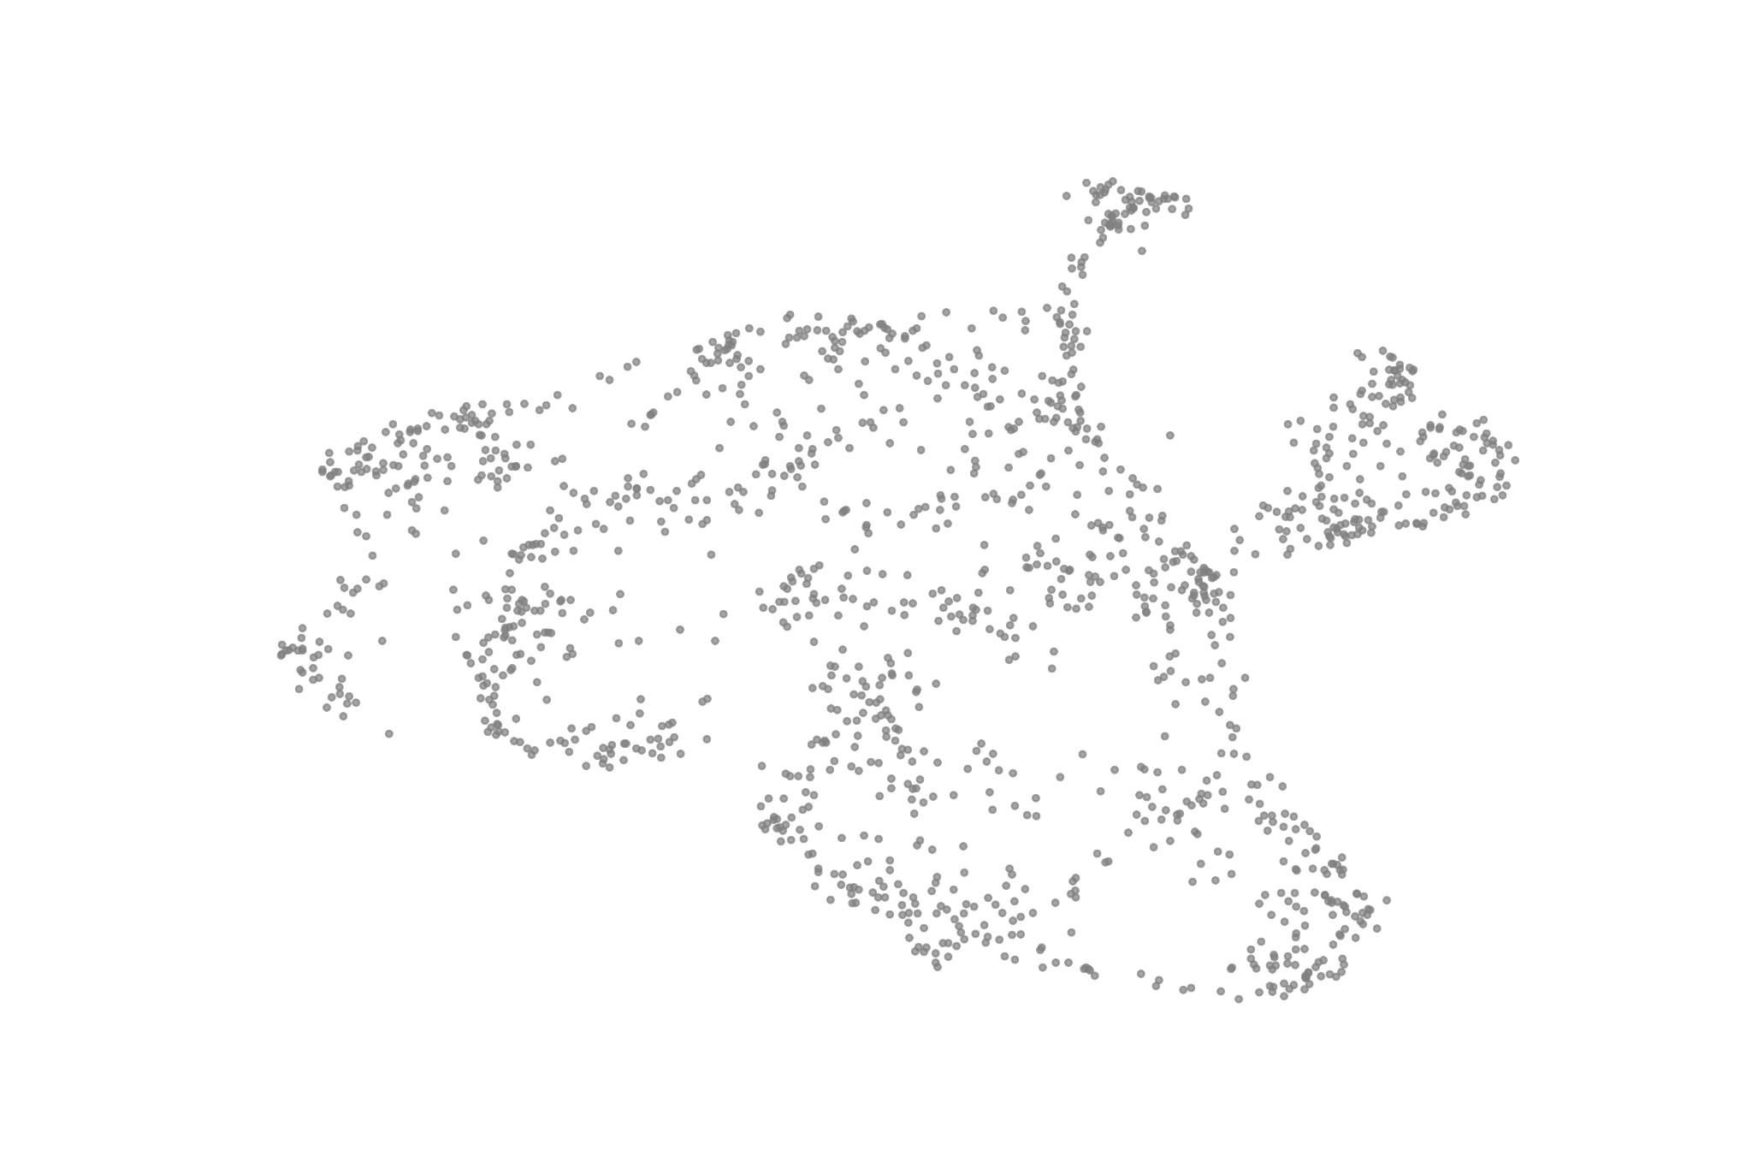
Dimensionality Reduction with UMAP
Feature space is high-dimensional → distances become less meaningful.
Can also use UMAP to embed events in 20D for clustering
Notes:
High-dimensional feature spaces are hard to visualize and can be tricky for clustering. So our next step is dimensionality reduction.
We use UMAP, which is a non-linear method that tries to preserve the local neighborhood structure of the data. Events that are similar in feature space end up close together in 2D; events that are very different are farther apart.
On this slide, you’re seeing each event as a single point in the 2D UMAP plane. At this stage, the colors are just [say what you used, maybe all grey, or colored by a simple property like timescale], but the important idea is that the structure in this plot reflects similarities in light-curve shape.

Slide 24
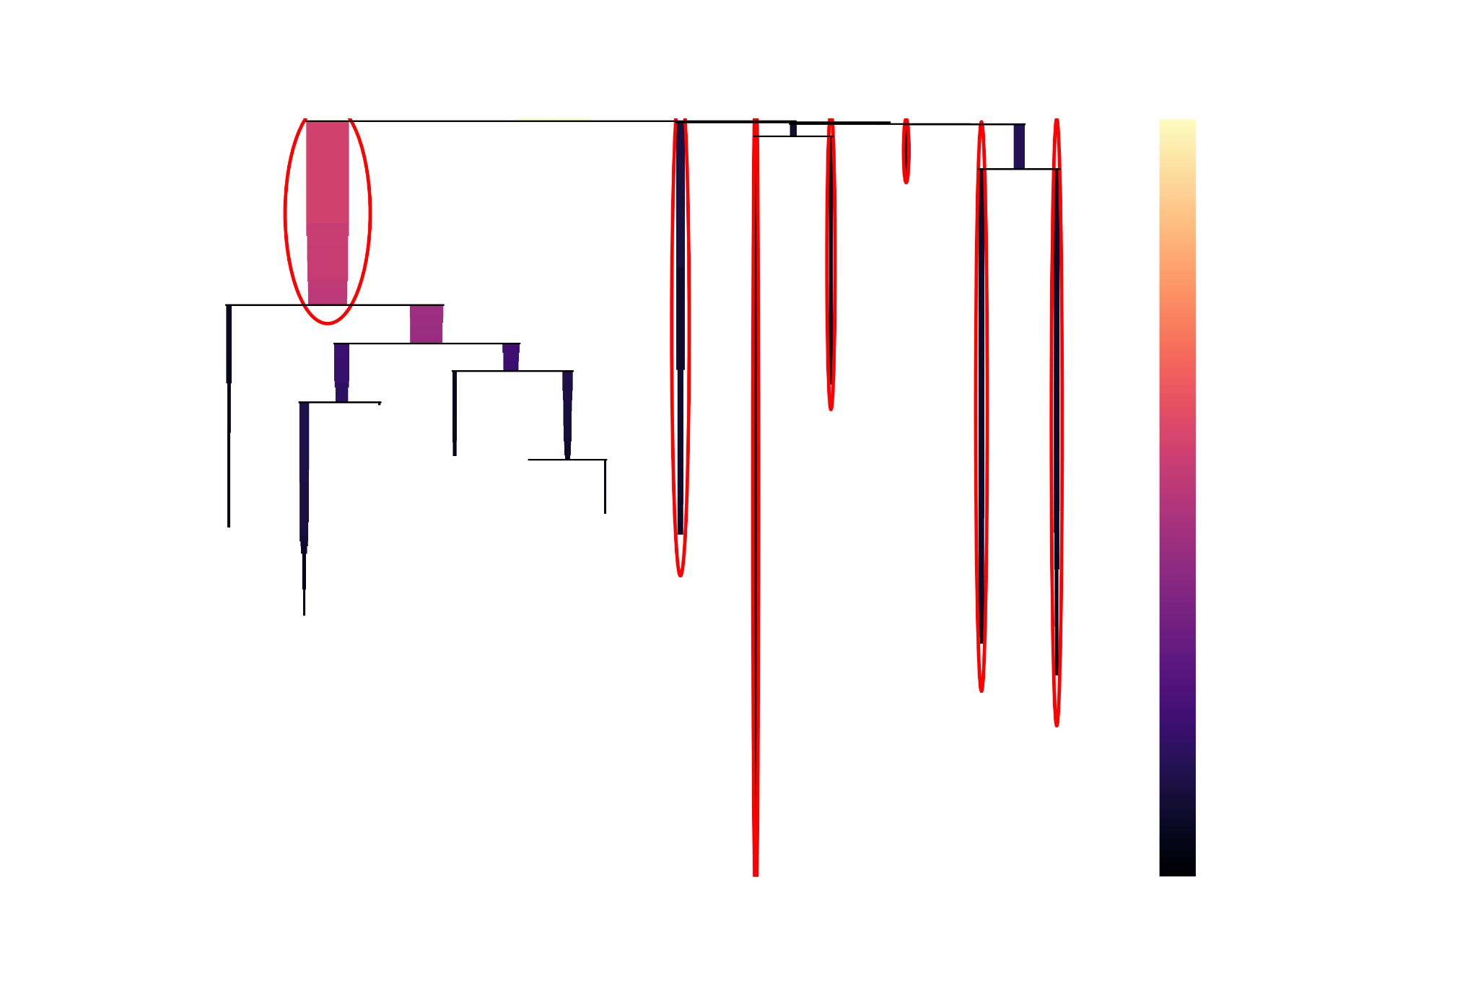
Clustering with HDBSCAN
Notes:
Once we have the 2D UMAP embedding, we apply HDBSCAN, which is a density-based clustering algorithm. It’s well-suited for this problem because it doesn’t force the data into spherical clusters and it can identify noise points.
Intuitively, HDBSCAN looks for regions in the UMAP plane where points are densely packed and assigns them to clusters. Points that are isolated or in low-density regions can be labeled as “noise.”
On this slide, you can see the same UMAP projection, but now each point is colored by its HDBSCAN cluster label, with noise in grey. You can see that the algorithm naturally finds [X] main clusters plus a cloud of outliers. These clusters are candidates for distinct families of microlensing light-curve morphologies.

Slide 25
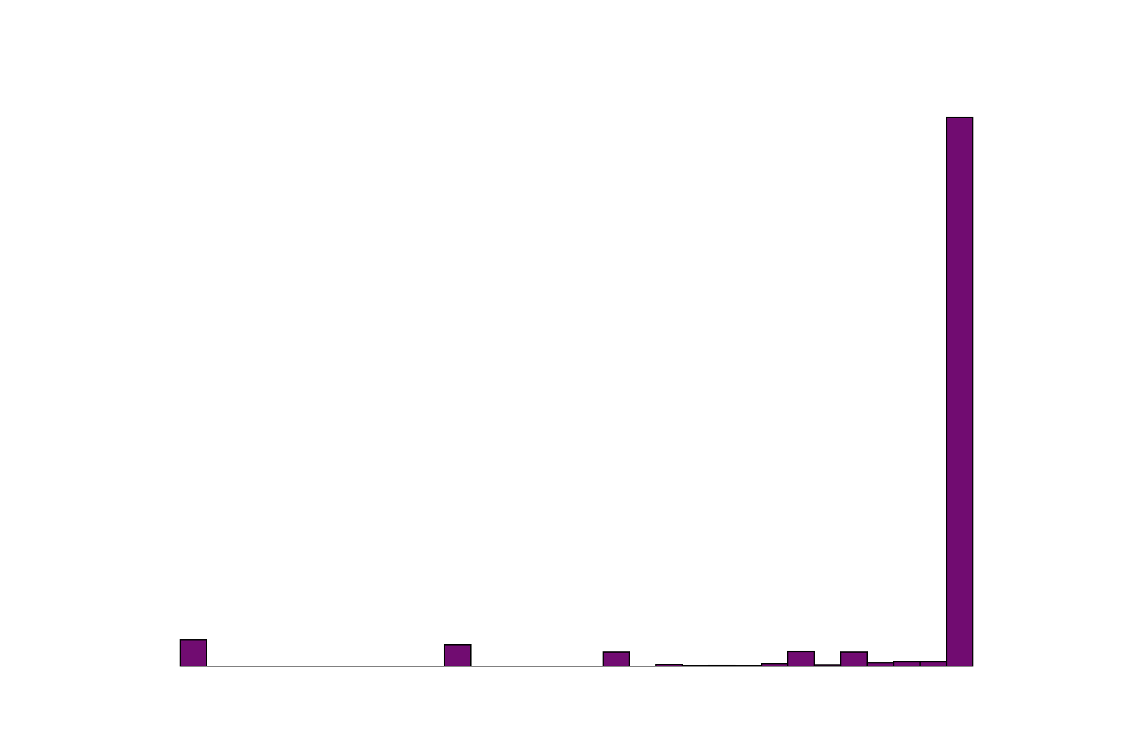
Clustering with HDBSCAN
Notes:
Once we have the 2D UMAP embedding, we apply HDBSCAN, which is a density-based clustering algorithm. It’s well-suited for this problem because it doesn’t force the data into spherical clusters and it can identify noise points.
Intuitively, HDBSCAN looks for regions in the UMAP plane where points are densely packed and assigns them to clusters. Points that are isolated or in low-density regions can be labeled as “noise.”
On this slide, you can see the same UMAP projection, but now each point is colored by its HDBSCAN cluster label, with noise in grey. You can see that the algorithm naturally finds [X] main clusters plus a cloud of outliers. These clusters are candidates for distinct families of microlensing light-curve morphologies.

Slide 26
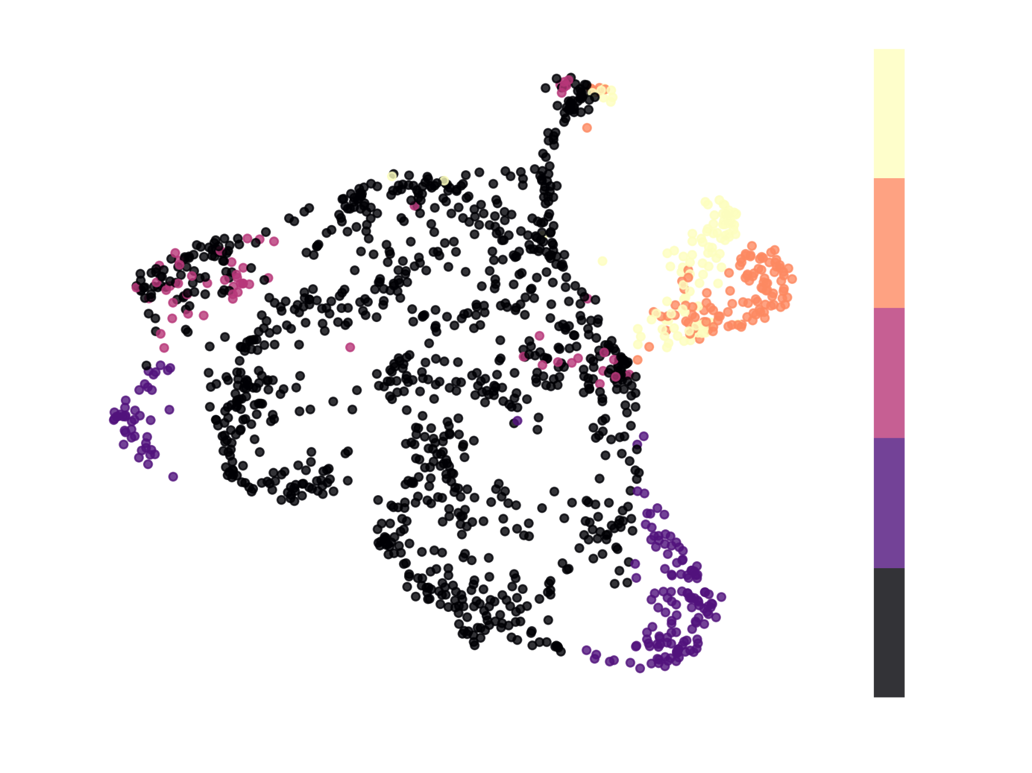
Cluster Strength
Ended up with more persistent clusters
Notes:
60 features -> UMAP to 20 features -> cluster

Slide 27
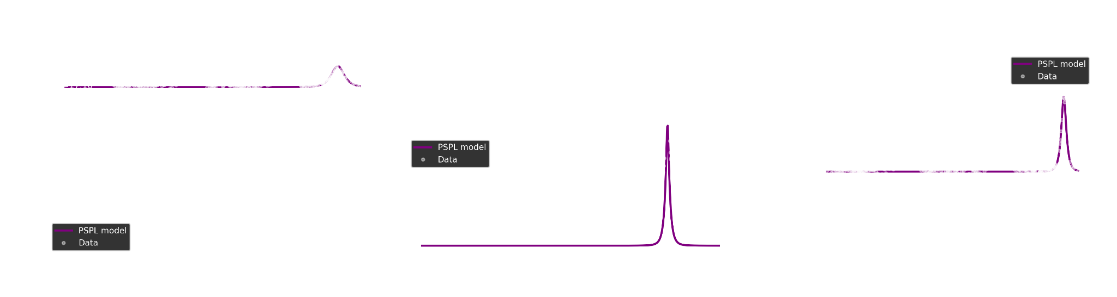
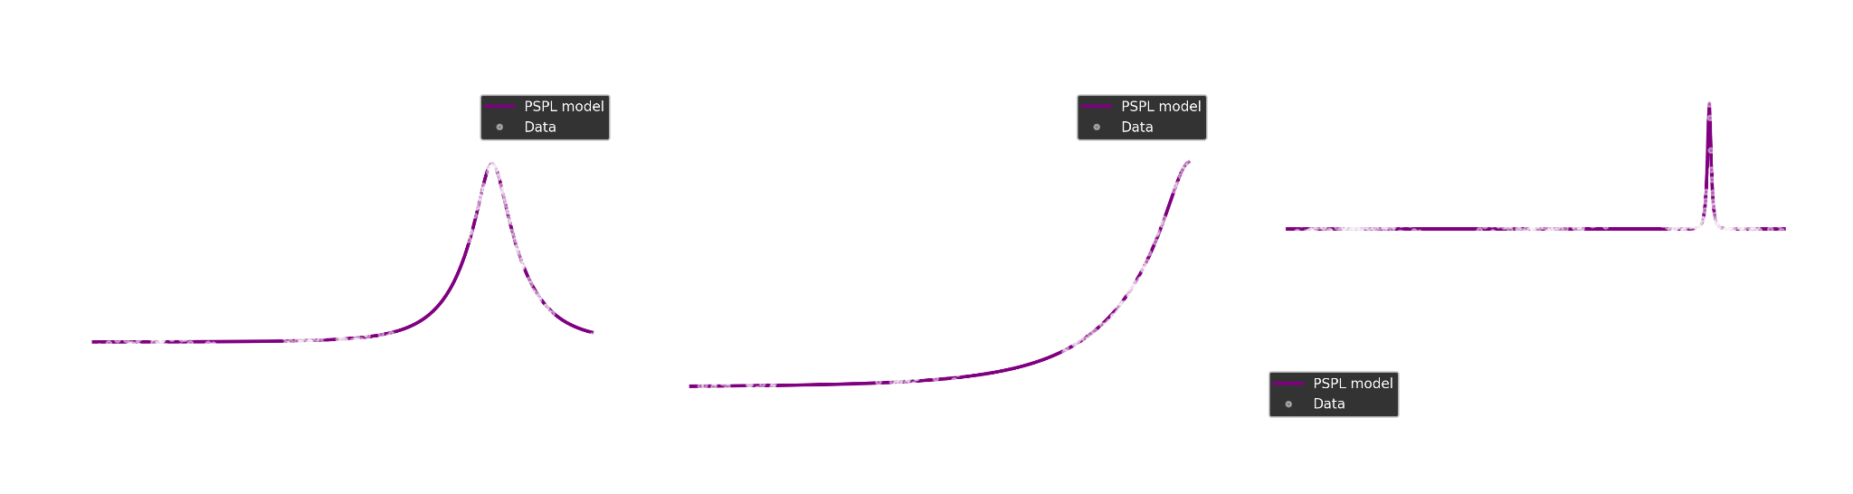
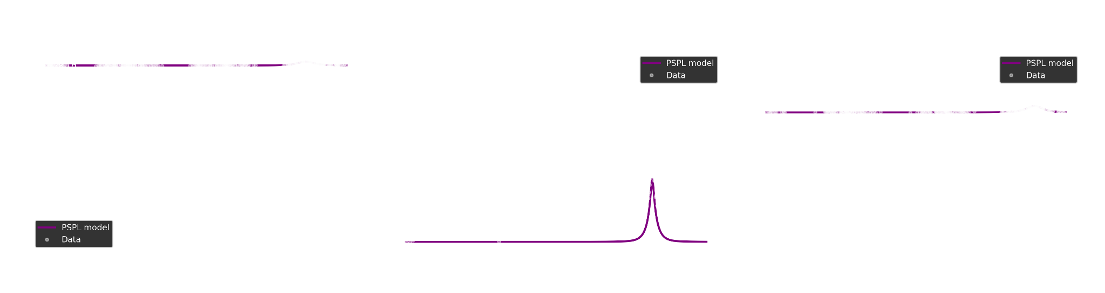
Notes:
To understand what these clusters actually mean, we go back to the light curves. For each major cluster, we look at representative events.
In the examples shown here, Cluster C0 [describe: e.g., “is dominated by clean, symmetric, single-lens-like curves”]. Cluster C1 [e.g., “tends to have asymmetries or shoulders”], and Cluster C2 [e.g., “contains clearly multi-peaked or caustic-like events”]. The noise points often correspond to events with sparse sampling, large gaps, or generally messy data.
The main takeaway is that the clustering is not arbitrary, each cluster has a recognizable light-curve style. That suggests that the combination of our features, UMAP, and HDBSCAN is capturing physically and observationally meaningful differences between events.

Slide 28
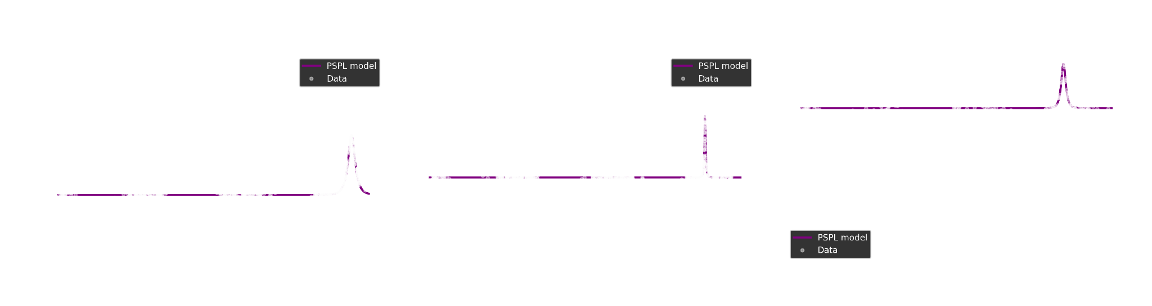
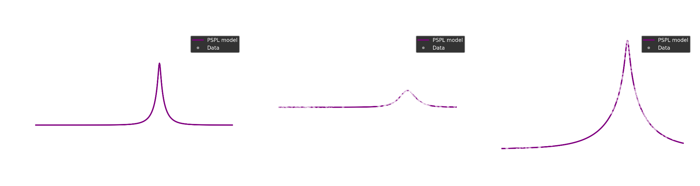
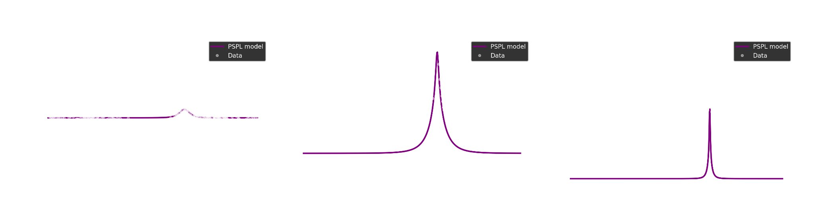
Notes:
To understand what these clusters actually mean, we go back to the light curves. For each major cluster, we look at representative events.
In the examples shown here, Cluster C0 [describe: e.g., “is dominated by clean, symmetric, single-lens-like curves”]. Cluster C1 [e.g., “tends to have asymmetries or shoulders”], and Cluster C2 [e.g., “contains clearly multi-peaked or caustic-like events”]. The noise points often correspond to events with sparse sampling, large gaps, or generally messy data.
The main takeaway is that the clustering is not arbitrary, each cluster has a recognizable light-curve style. That suggests that the combination of our features, UMAP, and HDBSCAN is capturing physically and observationally meaningful differences between events.

Slide 29
Challenges and Limitations
Feature set is still simple
UMAP + HDBSCAN hyperparameters matter:
Can split or merge clusters; tuning is non-trivial.
Data issues:
Irregular sampling and outliers can confuse clustering.
This is an unsupervised approach:
some clusters may be mixed physically distinct classes (needs better labels).
Notes:
There are several important caveats to keep in mind.
First, our feature set is still fairly basic. Microlensing light curves have rich structure, especially in caustic-crossing events, and more sophisticated shape descriptors could improve the separation between different physical classes.
Second, both UMAP and HDBSCAN have hyperparameters that can significantly change the result: things like the number of neighbors, the minimum cluster size, and the minimum samples. We tuned these manually, but a more systematic exploration or cross-validation would be ideal.
Third, the data themselves present challenges: irregular time sampling, seasonal gaps, and noise can all affect the features and potentially cause some events to be misclustered or labeled as noise. And finally, because this is unsupervised, the algorithm doesn’t “know” what a planet or a binary is, it just groups similar shapes. So some clusters may still mix different physical scenarios

Slide 30
Next Steps
Refine features (add color info, higher-order shape descriptors)
Incorporate more seasons / OGLE-IV data (older data has more remarks)
Explore integrating this clustering into the real-time EWS as a filter for exotic events.
Hierarchical analysis (HDBSCAN on each cluster)
Notes:
To summarize, we built a pipeline that:
takes OGLE microlensing light curves and constructs a set of morphology-sensitive features,
uses UMAP to embed those features into a 2D space that preserves local similarity, and
applies HDBSCAN to identify clusters of events with similar light-curve shapes.
We find that the resulting clusters correspond to recognizable families of microlensing events, from clean single-lens-like curves to more complex, possibly binary or planetary events, plus a population of noisy or poorly sampled outliers. This suggests that unsupervised learning can be a useful tool for organizing large microlensing samples and flagging interesting candidates.
Going forward, natural extensions include engineering richer shape features, incorporating more seasons or larger OGLE samples, and exploring how a clustering step like this could be integrated into a real-time pipeline to automatically highlight exotic events for follow-up.

Slide 31

github
github.com/abheekda1/ogle-microlensing-automation

Slide 32
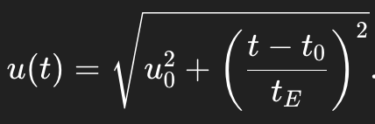
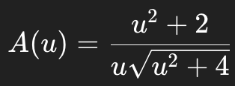

B1: PSPL Model Details

Slide 33
